Slide 1
TRAFFIC SIGNAL TIMINGS
Everything you ever wanted to know…

Slide 2
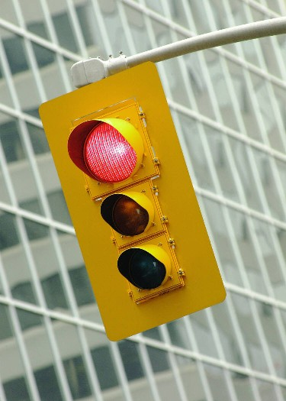
Introduction
Traffic signals equipment
Traffic signal timing basics
Clearance intervals (amber + all red)
Pedestrian timings
Modes of traffic signal control
Left-turn phases
Coordination with Synchro

Slide 3
Traffic Signals Equipment

Slide 4
What is this?

Slide 5
What is this?
  Traffic signal
  Signal
  Traffic control signal
What it is NOT
  Stop light
  Traffic light
  Light

Slide 6
Why do we need 2 traffic signal heads per approach?
If a lens burns out, motorists will be able to look at the display on the other signal head
A burned out RED is the most critical!

Slide 7
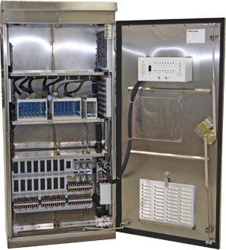
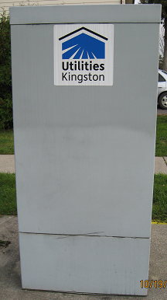

Controller & Cabinet
BRAINS of the signal
One controller at each intersection

Slide 8
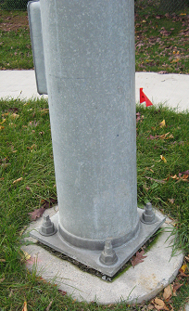
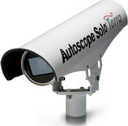
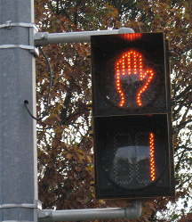
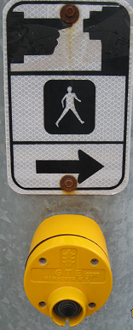
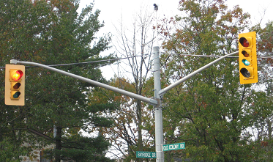

Hardware

Slide 9
Vehicle Detection
Allows traffic signals to respond to vehicle demand
Required at semi and fully-actuated intersections
Signal typically “rests” in green on main street until a vehicle is detected on the side street or a pedestrian presses the button to cross the main street
Detection equipment in Kingston includes loops imbedded in the pavement and video detection cameras

Slide 10
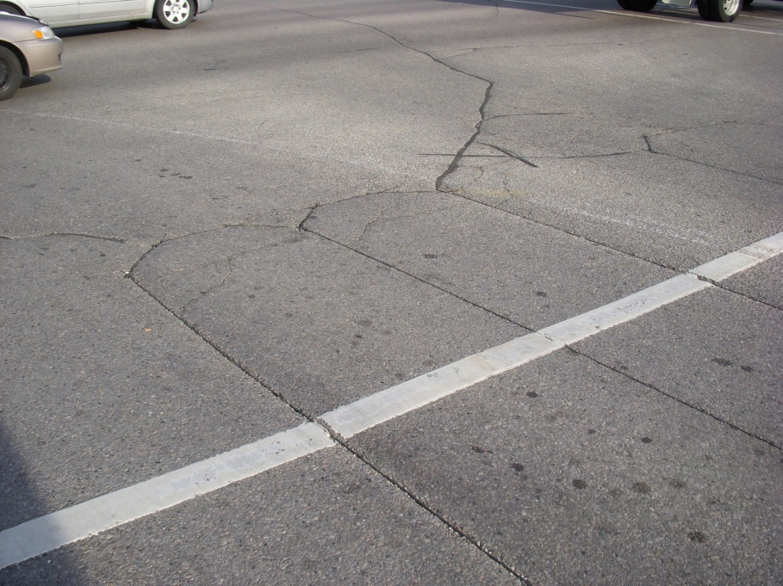
Vehicle Detection Loops
Inductive loops imbedded in the pavement, detect the presence of metal in a vehicle. As long as vehicles continue to drive over the loop, the green light will extend to the design maximum.

Slide 11
Vehicle Detection Cameras
Detect vehicles & bicycles in a “virtual loop”
Used at semi & fully-actuated signals
One pole-mounted camera per approach
Initially more $$ than inductive loops
Durable & not easily damaged
No asphalt cuts required
Useful during construction

Slide 12
Traffic Signal Timings...
Just the Basics

Slide 13
Signal Phasing
  A phase is a sequence of displays that govern one or more simultaneous movements at an intersection.

Slide 14
Traffic Signal Cycle Length
Total time to complete all phases in the traffic signal timing sequence

Slide 15
Cycle Length
Cycle lengths in Kingston vary from 70 to 130 seconds
Left-turn phases and wide pedestrian crossings require a higher cycle length
Minimum pedestrian crossing times often dictate the cycle length
Traffic signals along a corridor MUST have the same cycle length in order to be co-ordinated!
A high cycle length often creates lengthy delays, especially on the side street

Slide 16
Factors that affect the length of the green light….
Consider the “Level of Service” (LOS) and “Volume-to-Capacity Ratio” (v/c) to balance delays . (Use software such as Synchro)
Pedestrian crossing times
Usually no less than 10 seconds for a through phase
Usually no less than 5 seconds for a left-turn phase
Cycle length – longer not always better!

Slide 17
Volume to Capacity
V/C ratios estimate the level of congestion at an intersection or roadway.
V/C = 0.90 is considered the limit of acceptable operation in an urban environment
  V/C ratio > 1.0 = severe congestion
  V/C ratio 0.75 to 1.0 = heavy congestion
  V/C ratio 0.50 to 0.74 = moderate congestion
  V/C ratio < 0.5 = low or no congestion

Slide 18
Level of Service (LOS)
A qualitative measure of capacity and operating conditions
Directly related to vehicle delay
LOS is given a letter designation from A to F, with LOS representing very short delays and LOS F representing very long delays
LOS D is considered the limit of acceptable operation in an urban environment
LOS C is the desired condition

Slide 19
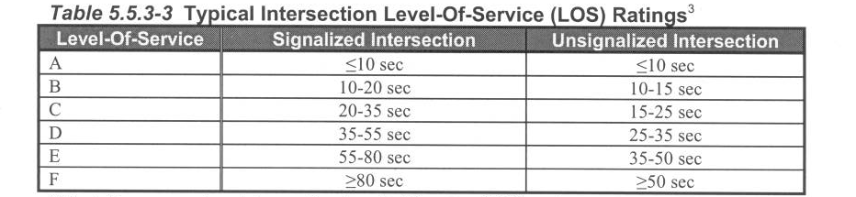
Level of Service (LOS)Ratings
Source: Highway Capacity Manual
Average delay per vehicle

Slide 20
Vehicle Clearance Intervals
Intergreen = Amber + All-Red

Slide 21
Intergreen
The time between the end of the green interval for one phase and the beginning of the earliest green interval for the next phase in the same signal cycle
Separates conflicting movements
MUST be an amber interval and an all-red interval

Slide 22
Vehicle Clearance Intervals
Amber is based on posted speed limit
All-red is based on distance for a vehicle to clear the intersection AND posted speed limit
The City of Kingston uses MTO clearance interval tables (Ontario Traffic Manual Book 12)

Slide 23
MTO Amber Clearance Intervals
Posted Speed (km/h) | 40 | 50 | 60 | 70 | 80
*Amber clearance (seconds) *includes 1.0 second perception + reaction | 3.0 | 3.3 | 3.7 | 4.2 | 4.6

Slide 24
All Red Clearance Intervals
(Distance to clear intersection)
Clearing distance = W + L
W = width of intersection from nearside stopbar to farside outer edge of crosswalk. If there is no crosswalk, measure to far side of outside lane.
L = length of vehicle = 6 metres

Slide 25
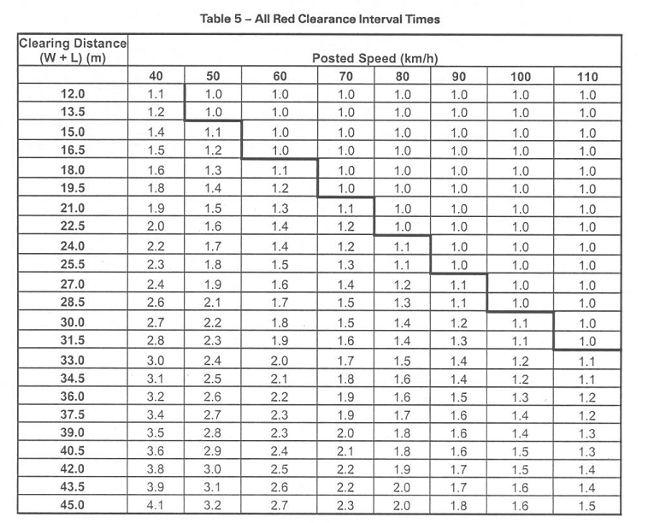
All Red Clearance Intervals
(Distance to clear intersection)

Slide 26
The Dilemma Zone
The area approaching the stop line in which the motorist, on the start of amber, will be momentarily undecided as to whether to stop or continue through the intersection, thereby encountering a dilemma.

Slide 27

The Dilemma Zone is NOT…..
Wondering aloud whether or not you should have eaten that second burrito!

Slide 28
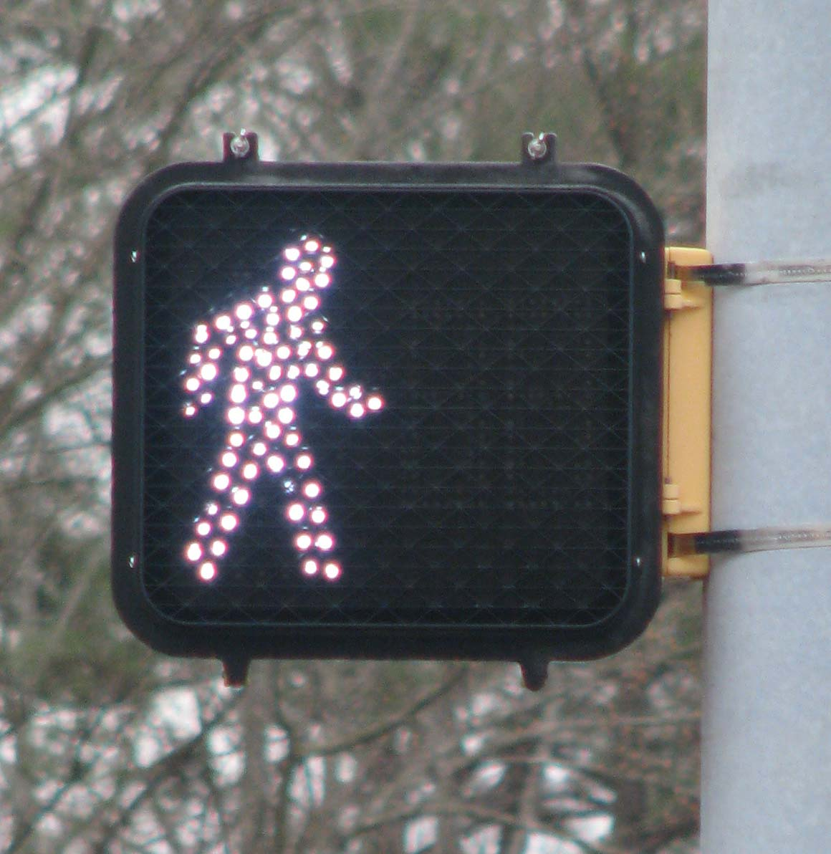
Pedestrian Timings

Slide 29
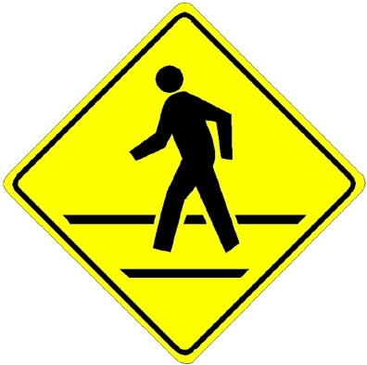
Pedestrian Timings
Walk = minimum of 7 to 10 seconds
Walk speed = 1.0 to 1.2 m/s
Red hand flash = time needed to cross the road from curb to curb
Solid red hand = vehicle amber + all-red

Slide 30
Signal Timings – Fixed Time
Brock & King Street

Slide 31
Signal Timings
Princess & Centennial

Slide 32
Modes of
Traffic Signal Control
Fixed Time
Semi-Actuated
Fully Actuated

Slide 33
Modes of Control
Fixed Time (Pre-timed)
Used throughout Kingston’s downtown
The length of each green light is ALWAYS the same
No vehicle detection
No pedestrian buttons
Good for short cycle lengths (70 to 80 seconds)
Works well when there are no left-turn phases
Pedestrian friendly (fewer delays)
Easiest for co-ordination

Slide 34
Signal Timings – Fixed Time
Brock & King Street

Slide 35
Modes of Control
Semi-Actuated
Used at intersections with high volumes on main street and relatively low volumes on side street (Montreal & Stephen Street)
Length of green light on main street always the same (when running uncoordinated & free)
Length of green light on the side street varies with demand
Vehicle detection on side street only
Pedestrian buttons to cross main street only
More difficult to co-ordinate than fixed time signals

Slide 36
Signal Timings – Semi-Actuated
Montreal & Stephen Street

Slide 37
Modes of Control
Fully-Actuated
Used at intersections with high volumes on main street and low to high volumes on side street (used at most intersections outside of Kingston’s downtown)
Length of ALL green lights and ALL left-turn arrows on ALL approaches VARY with demand!
Pedestrian buttons usually to cross main street only unless both streets are major
Difficult to co-ordinate because length of green lights are variable

Slide 38
Signal Timings – Fully Actuated
Centennial & Davis

Slide 39
Signal Timings
Princess & Centennial

Slide 40
Signal Timings
Gardiners & Taylor Kidd

Slide 41

Left-Turn Phases
Fully Protected
Partially Protected
Permissive

Slide 42
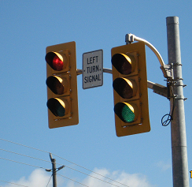
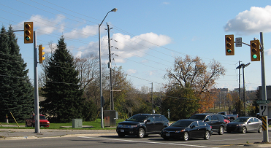
Fully Protected Left-Turn Phase

Slide 43
Fully Protected Left-Turn Phases
  Can only turn left when green arrow is displayed
  Not permitted to turn left when solid green ball is displayed for through vehicles EVEN if there is a gap
  Requires two left-turn signal heads and special signage
  Must display amber + all-red after the green arrow
  Increases overall intersection delays, especially left-turning vehicles
  FRUSTRATE MOTORISTS when traffic volumes are low, especially during the night

Slide 44
When should fully-protected left-turn phases operate?
  Double left-turning lanes
  Limited sight distance
  High number of left-turning collisions
  3 or more lanes of oncoming traffic

Slide 45
Partially Protected Left-Turn Phases
(Protected-Permissive)
  Can turn left when green arrow is displayed AND during the solid green if there is a gap in oncoming traffic
  Requires only one signal head with a left-turn arrow
  Requires only amber clearance (no all-red)
  Fewer delays than at fully protected left-turn phases

Slide 46
When should partially-protected left-turn phases be considered?
  Concerns from the public! Kingston drivers EXPECT left-turn phases almost everywhere.
  When left-turning vehicles are delayed for more than one cycle
  Vehicles spilling out of turn lane and blocking through lane
  More than two vehicles per cycle turning during intergreen (amber + all-red)

Slide 47
Permissive Left-Turn
  NO LEFT TURN ARROW
  Can turn left during the solid green if there is a gap in oncoming traffic
  Most efficient for intersection operation but left-turning vehicles may experience delays and increased collision risk

Slide 48

Questions

